Slide 1

Software Bug Tracking and Reporting Tool (BugTrackR)
Presented By:
Harishmitha Raja (hr200)

Slide 2

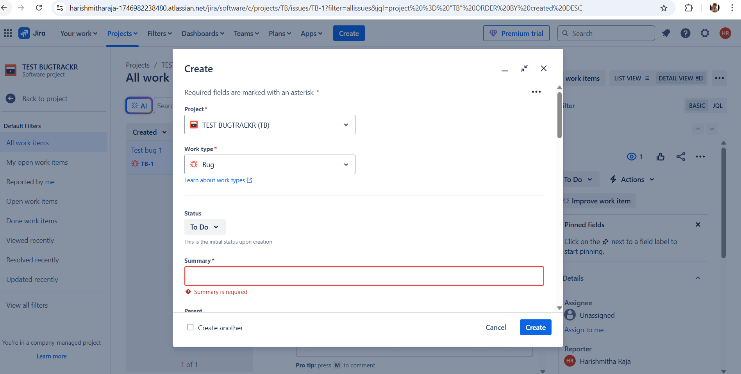
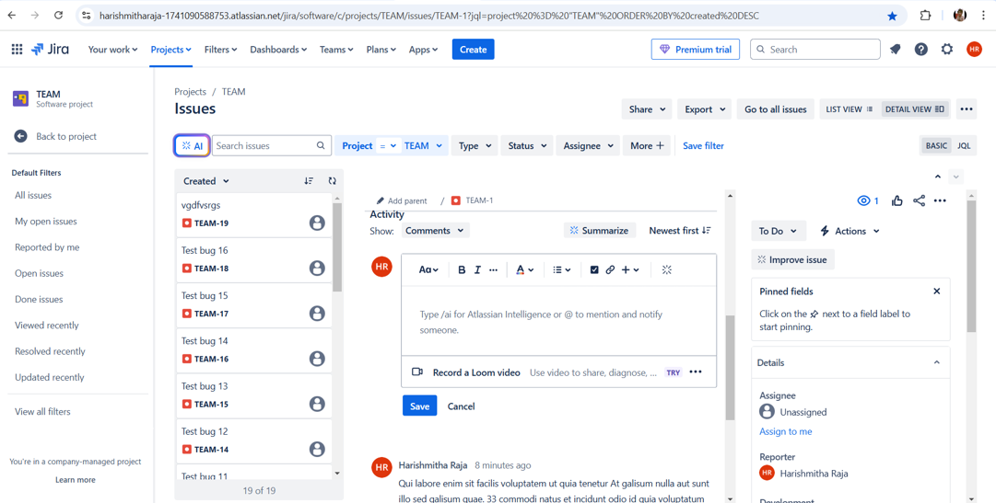




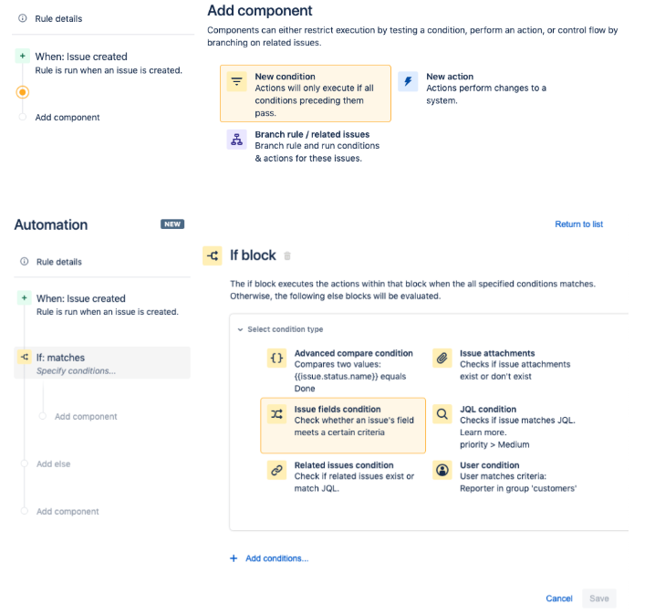
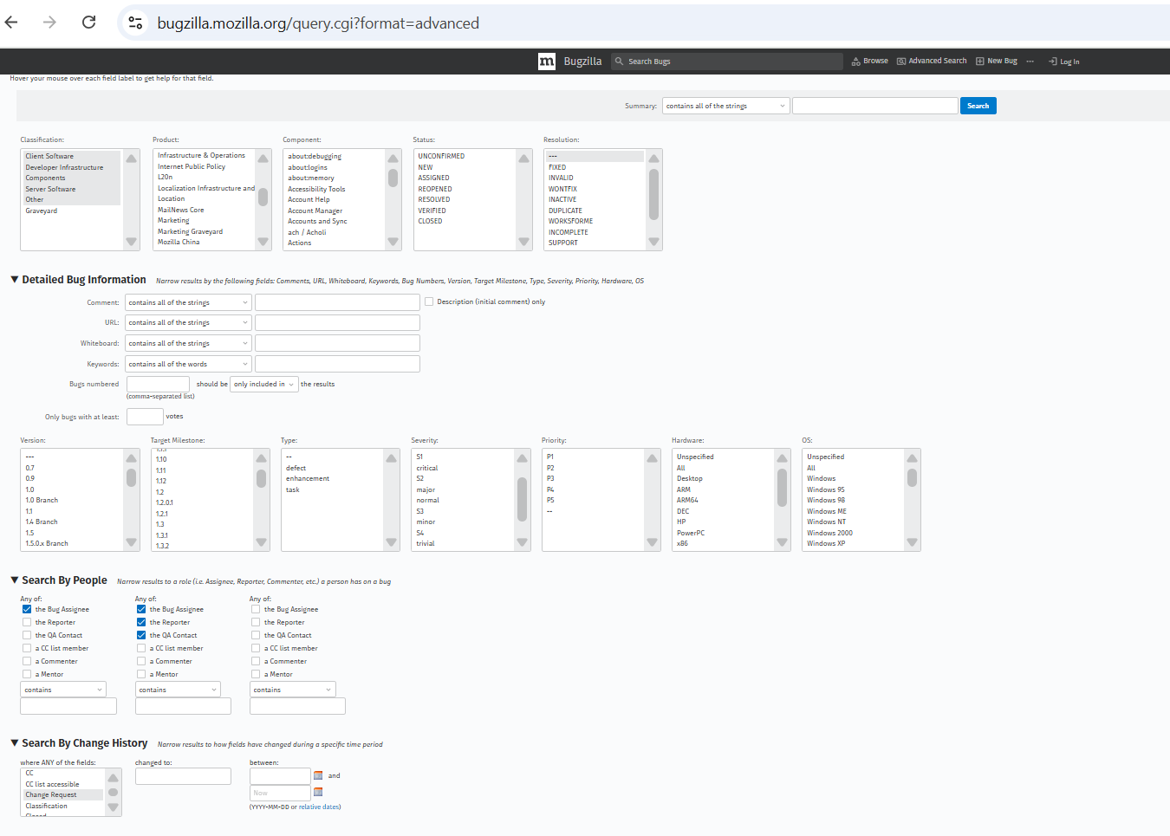


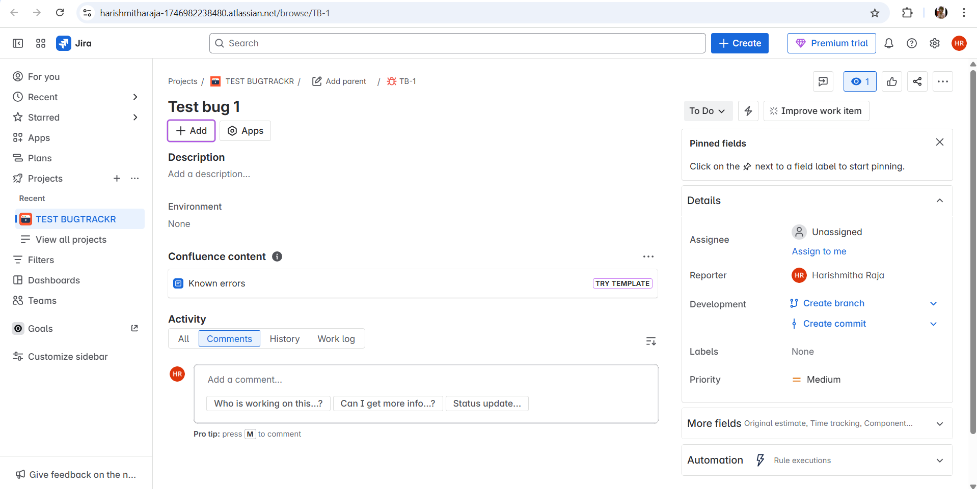






Motivation
Duplicate reports
Lack of standardized reports
Slow bug assignment
Scalability and Usability issues
Poor collaboration

Slide 3






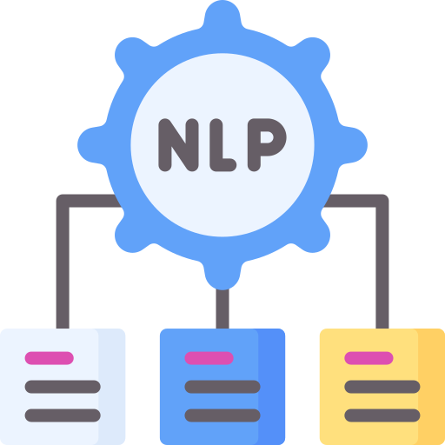







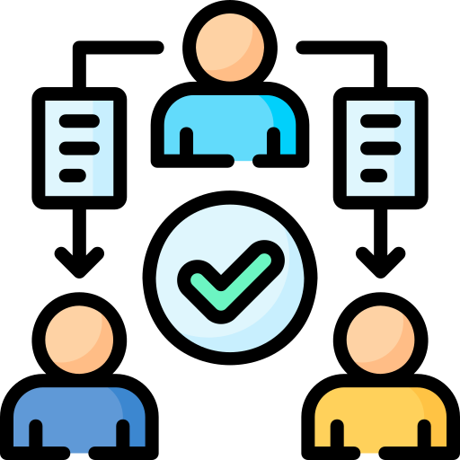
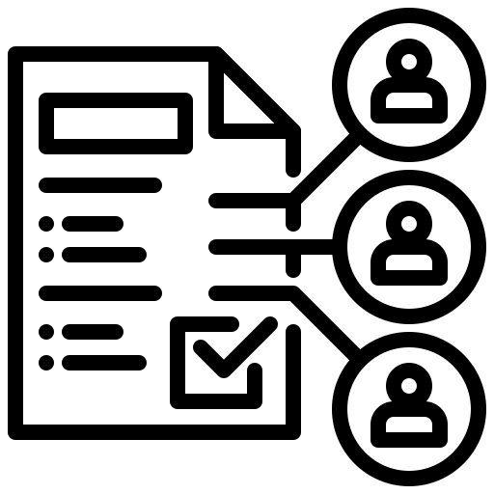

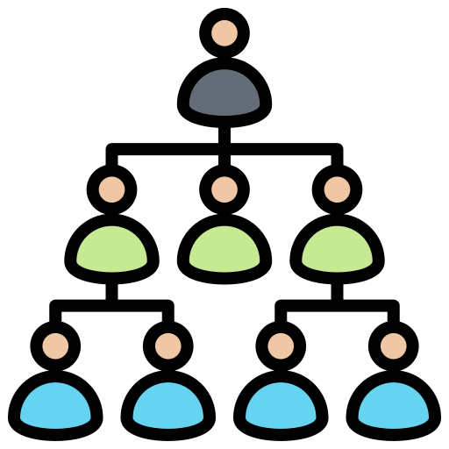
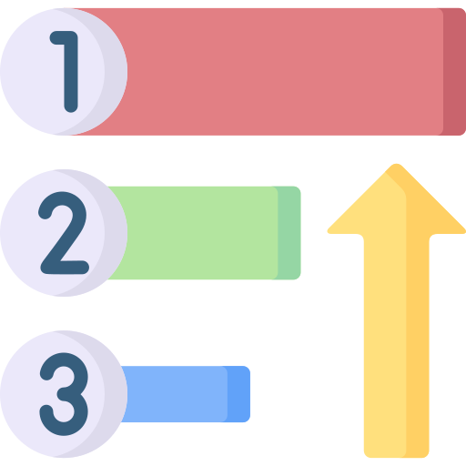




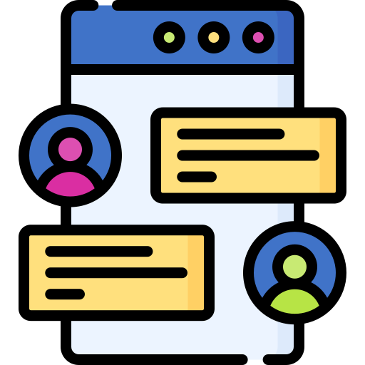


Aims and Objectives
Structured and secure role-based bug reporting and tracking
Duplicate bug detection to avoid redundant reports
Advanced search and filtering for better bugs management
Automated bug assignment based on workload, priority, team and seniority
Role-based analytics for better decision-making
Structured communication through internal comment for tech users and real-time chat between reporters and technical roles

Slide 4
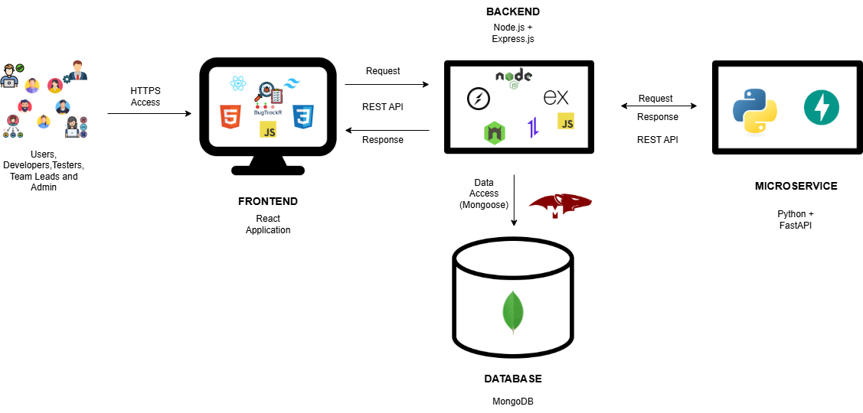
System Overview & Architecture
User Roles: Five user roles - General User, Developer, Tester, Team Lead, Admin.
Client-Server Flow: All roles interact via a React frontend that talks to a RESTful Node.js backend.
Microservice: Backend communicates with a FastAPI NLP microservice for duplicate detection, semantic search and priority classification.
Database Layer: MongoDB is used with Mongoose for schema-driven data modeling.

Slide 5
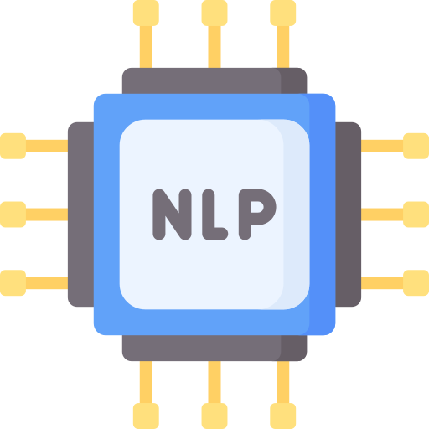










Challenges
NLP Techniques
Limited API & database experience
Ensuring Security & Access Control
Automated bug assignment
Real-Time collaboration

Slide 6







Technical Specification

Slide 7
Timeplan

Slide 8
Demo

Slide 9
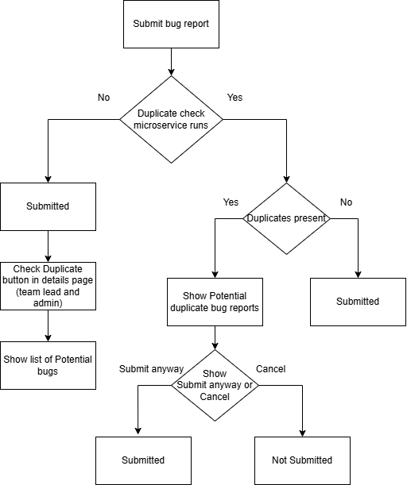
Automated Duplicate Detection
Flow
Drawn using draw.io []

Slide 10
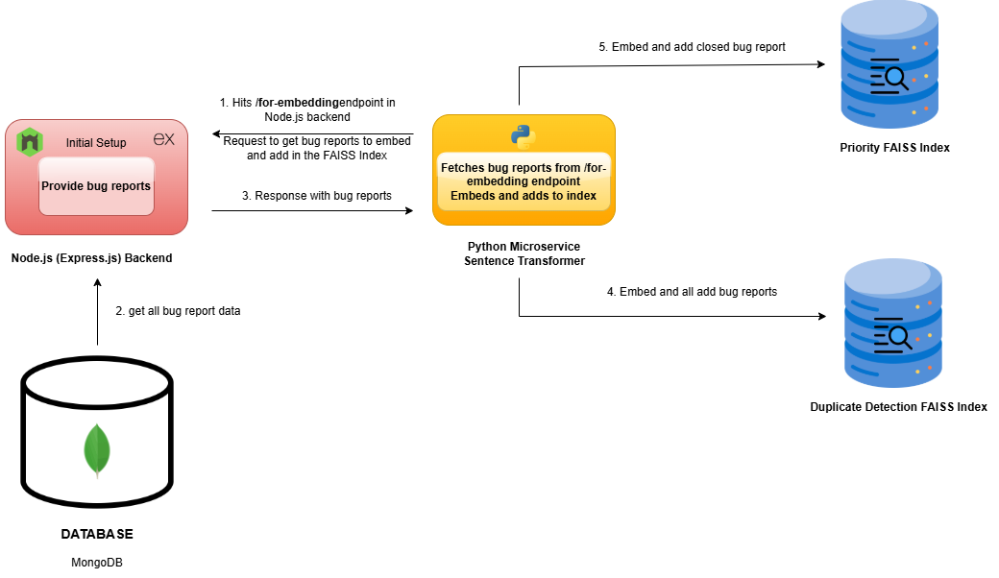
Initial Embedding for Semantic Features

Slide 11
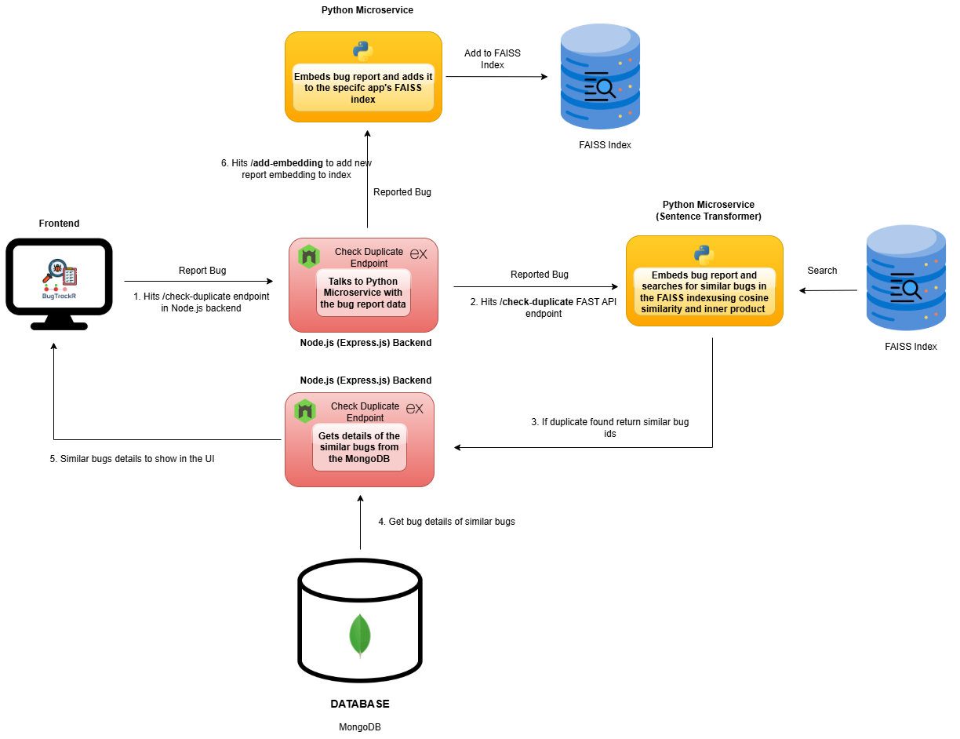
Duplicate Detection Design
Note: Same index for semantic search as well

Slide 12
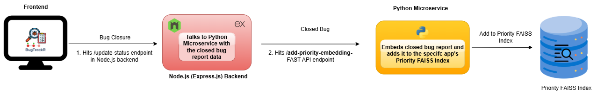
Priority Classification Design

Slide 13
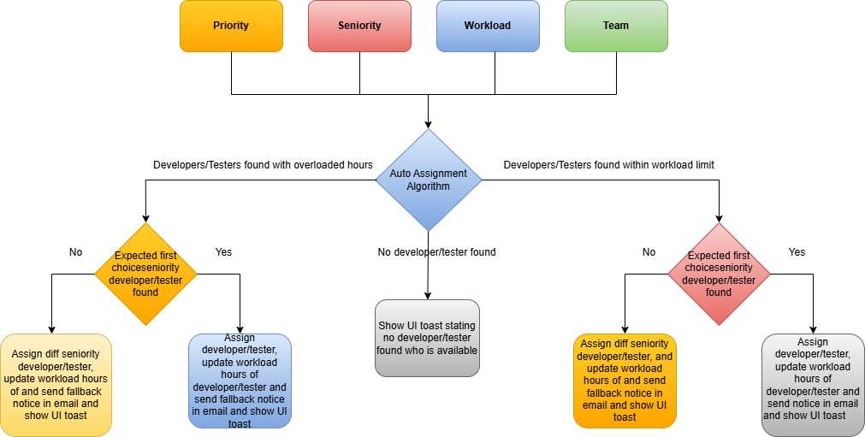
Auto Assignment Design

Slide 14
Real-time chat and mention-based comment
Chat System
Reporters and technical users can interact via real-time chat
Built using Socket.io (WebSockets)
Supports per-bug private channels
Mention-Based Comments
Technical users (developers, testers, team leads) can tag others using @name
Triggers real-time email notification to the mentioned user

Slide 15
Time-Based Alerts for Bug Resolution
Critical Bug Closure
Scheduled job run every two hours from 9AM to 5PM (Mon-Fri)
No Status Update
Scheduled job run every day at 10AM to check for bugs that did not hav status update for 24 hours and UI Flag
Unassigned bug (team)
Scheduled job run every two hours from 9AM to 5PM (Mon-Fri) to check for bugs that are not assigned to any team

Slide 16
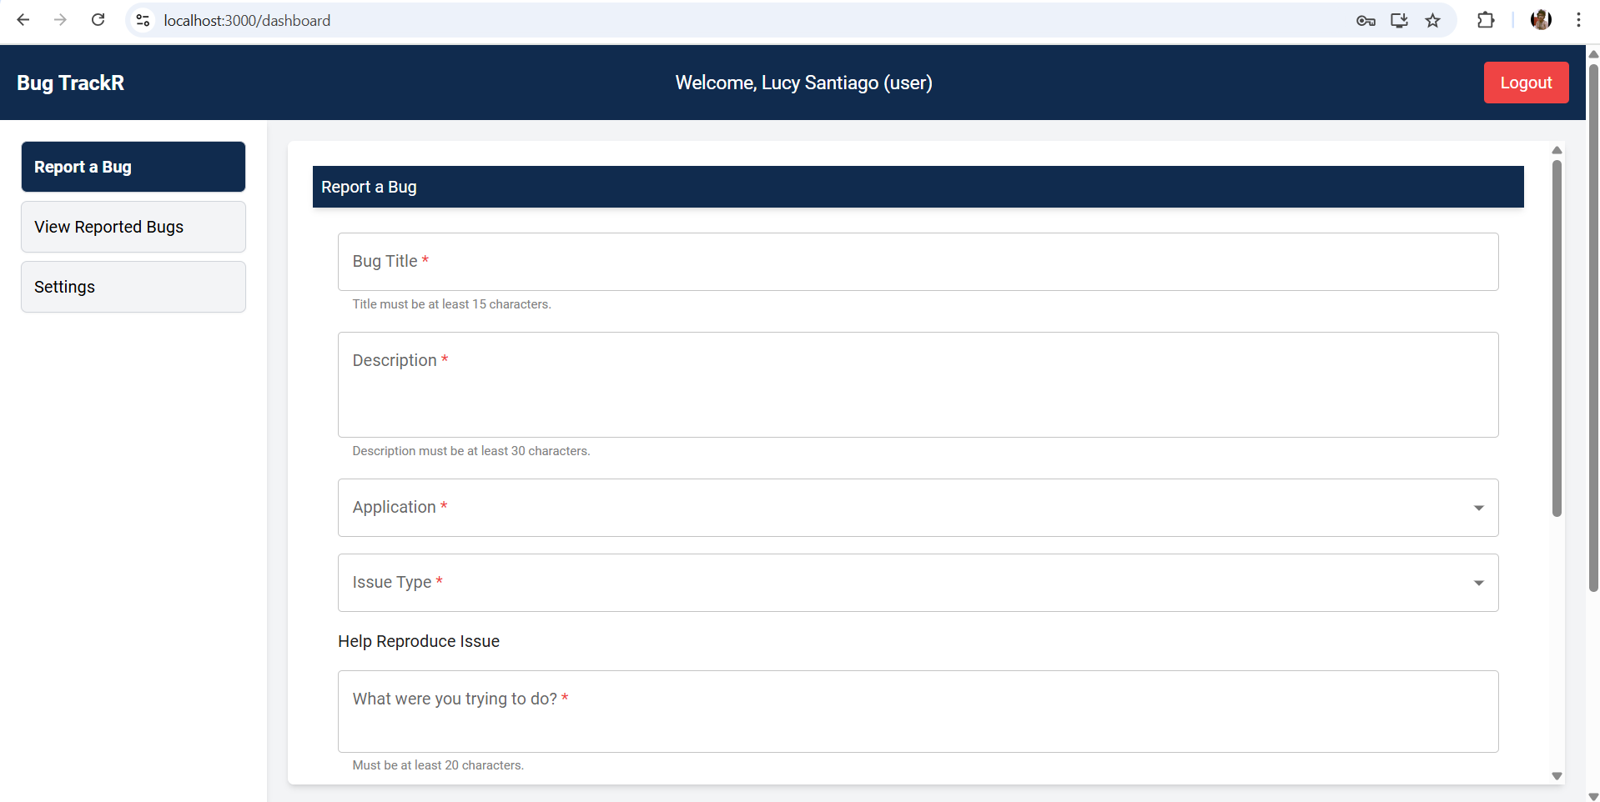
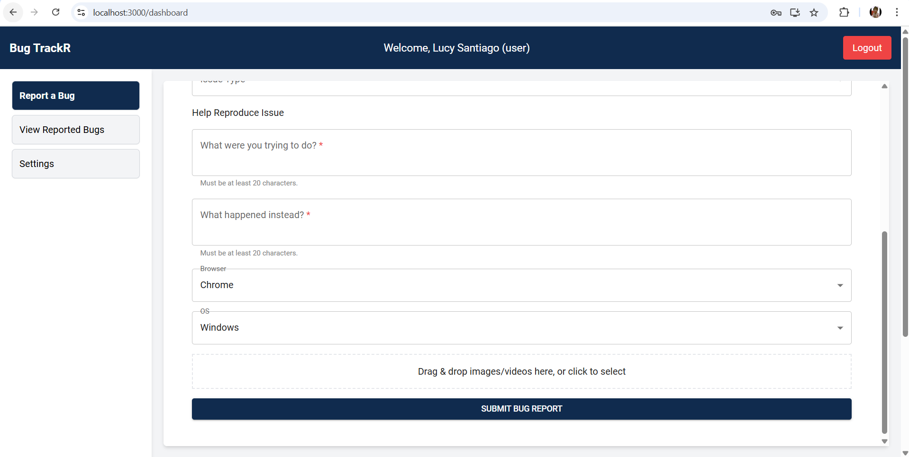
Comparison with Existing Tools

Slide 17
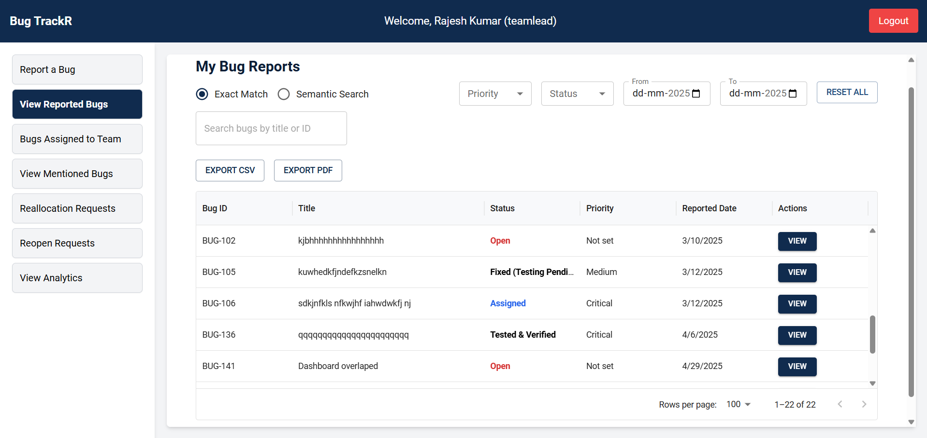
Comparison with Existing Tools

Slide 18
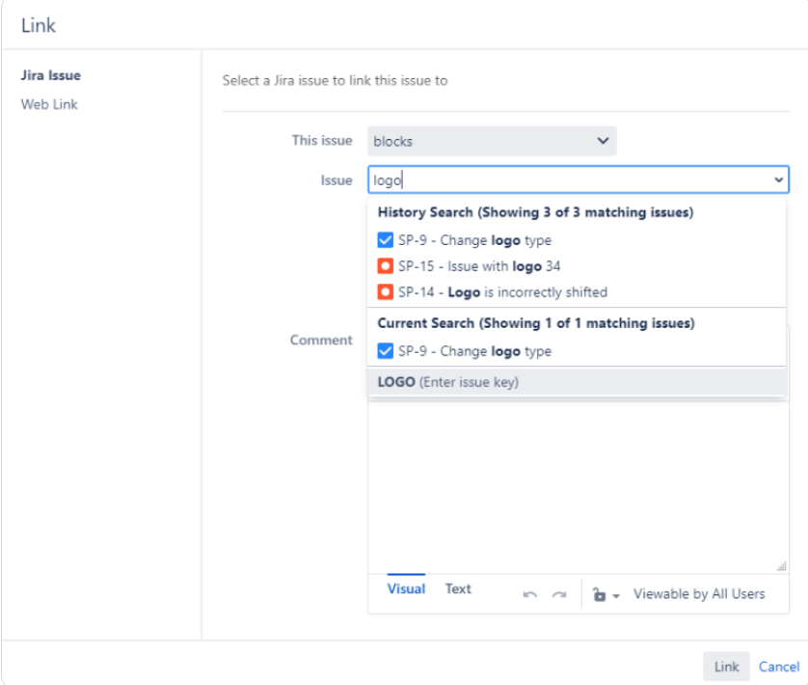
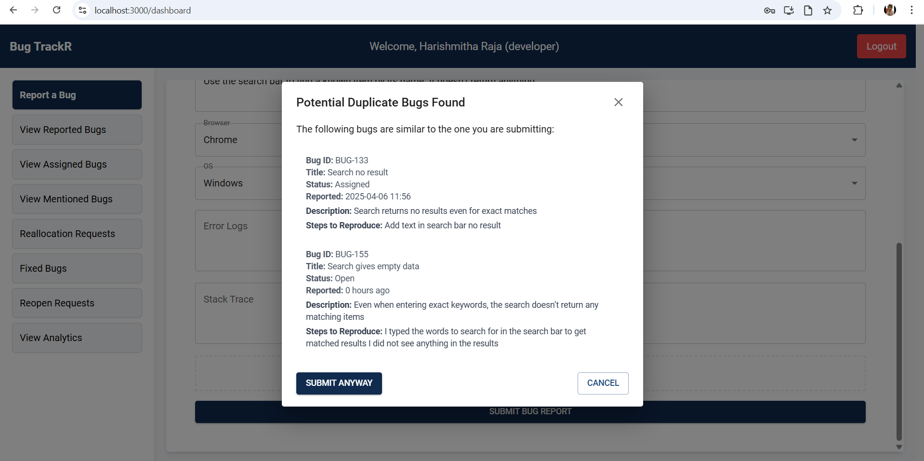
Comparison with Existing Tools

Slide 19
Questions?

Slide 20
Thank you

Slide 21
References
[1] Nataliya Vasyliv. “How to Find Duplicates in Jira?” Reliex.com, Reliex, 2023, https://reliex.com/blog/how-to-find-duplicates-in-jira
[2] Admin. “Automatically Assign Issues - JIRA Automation - Tech Agilist.” Tech Agilist, 4 Mar. 2023, www.techagilist.com/agile/jira/automatically-assign-issues-jira-automation/.
[3] Flaticon. “Flaticon, the Largest Database of Free Vector Icons.” Flaticon, 2010, www.flaticon.com/
[4] IcePanel Technologies Inc. “TechIcons.” Techicons.dev, 2024. https://techicons.dev/
[5] draw.io. “Flowchart Maker & Online Diagram Software.” App.diagrams.net, 2025, app.diagrams.net/.

